Slide 1

HOW TO INSTALL GEIFACTURE LOCAL and LIVE

Slide 2

LOCAL SERVER
In this example, I am using WAMPSERVER, but you can use any!

Slide 3
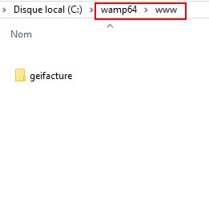
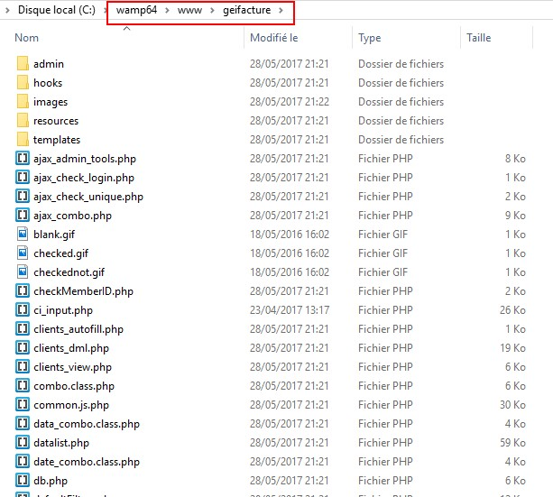
STEP 1
Run your server and Unzip ‘GEIFACTURE’ downloaded from CodeCanyon and place it in your local server folder.

Slide 4
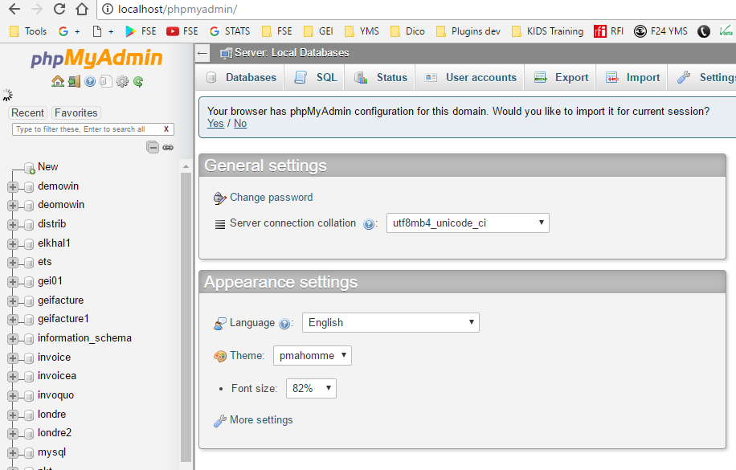
STEP 2
Connect to your local server ‘localhost/phpMyAdmin/’

Slide 5
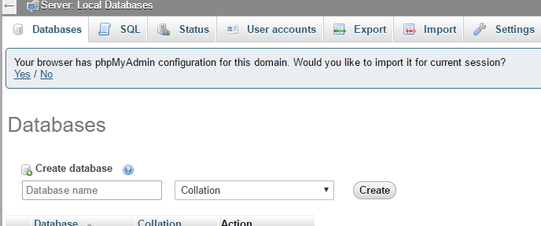
STEP 3
Click on ‘Databases’ and create a new database
In this example, I will call my database‘demo1’

Slide 6
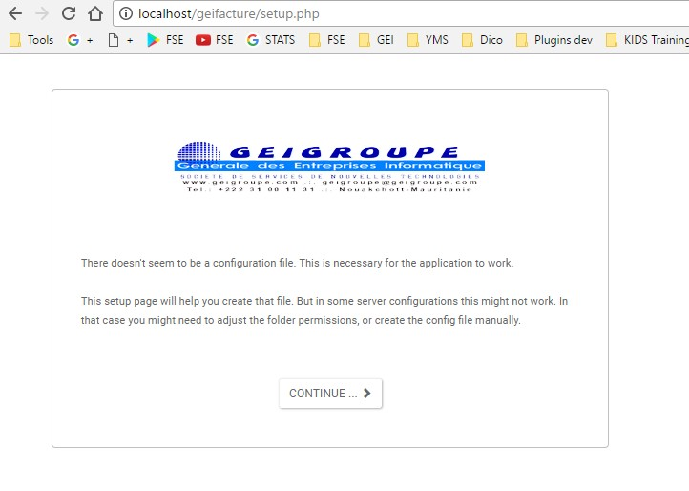
STEP 4
Open your browser and type ‘localhost/geifacture/’ and press ‘ENTER’
Click on ‘CONTINUE …’

Slide 7
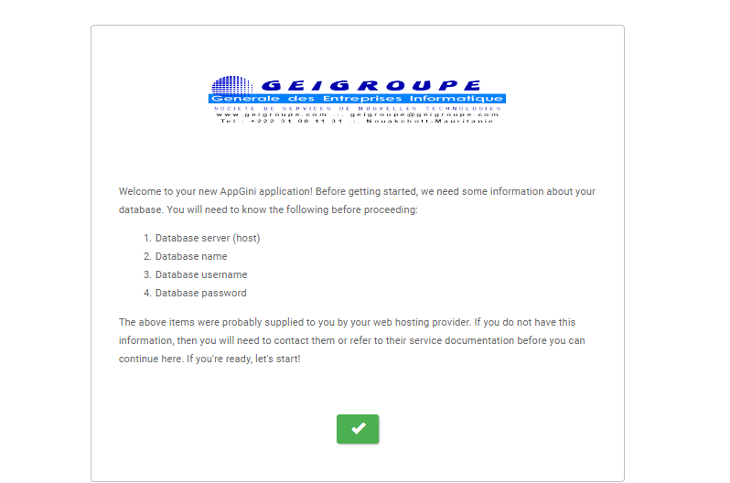
STEP 5
Click on ‘THE GREEN BUTTON …’

Slide 8
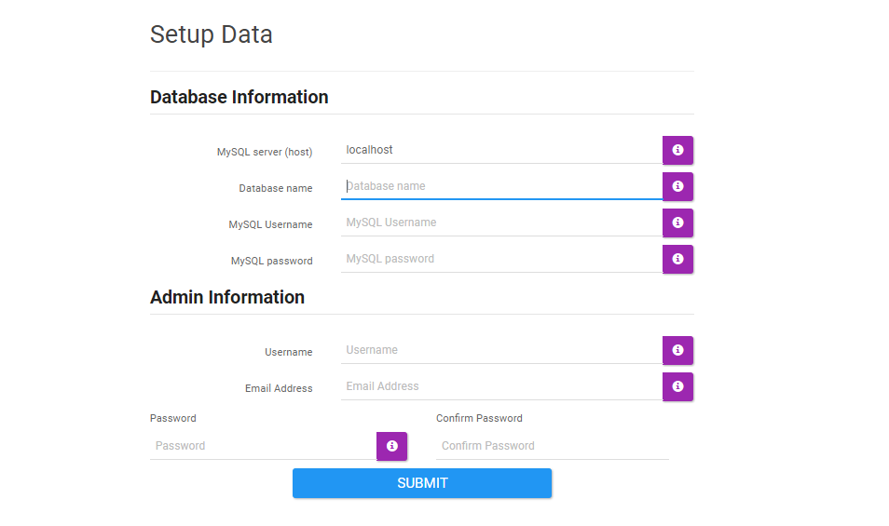
STEP 6
Fill on ‘INFORMATIONS…’
demo1
root
I am using here default username, you can use yours. I my case I do not have password, I leave empty.
admin
You can follow my example or use your own information
geigroupe@geigroupe.com
123456
123456
When done, click on ‘SUBMIT’

Slide 9
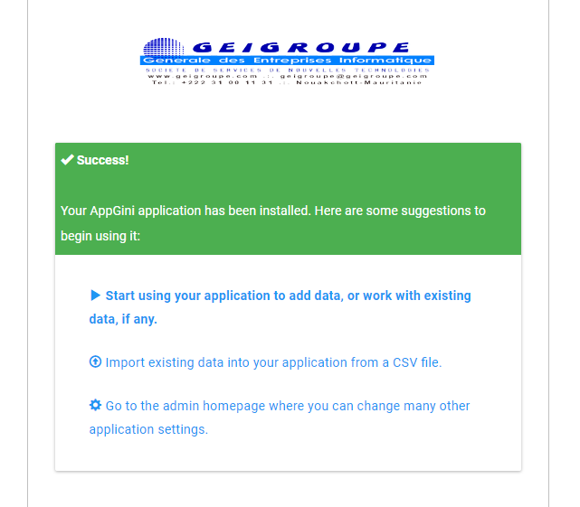
STEP 7
You are now ready to use the application.
You can click here to start using the application
Or you can click here to manage the application

Slide 10

LIVE SERVER

Slide 11
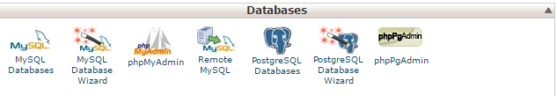
STEP 1
Connect to your cPanel
Click on ‘MySQL Database Wizard’

Slide 12
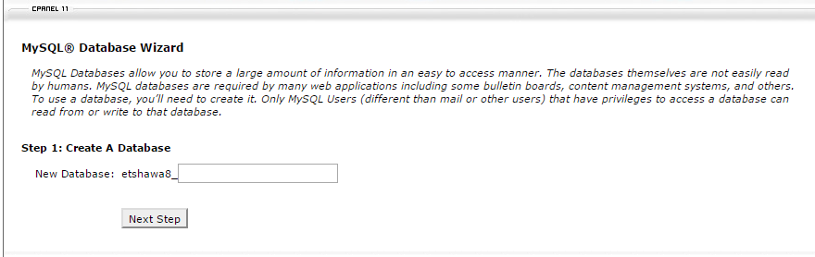
STEP 2
Choose a name for your database
db_name
Write your database name and click ‘Next Step’

Slide 13
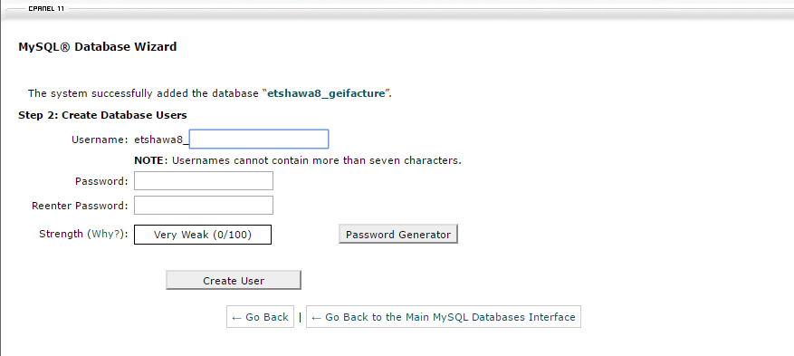
STEP 3
Choose ‘Username and Password’
username
password
password
Click ‘Create User’

Slide 14
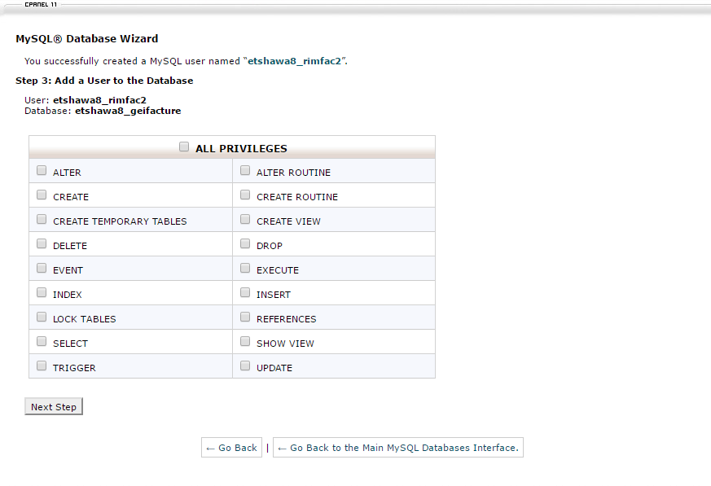
STEP 4
Click on ‘ALL PRIVILIGES’ to grant all privileges
username
Click ‘Next Step’

Slide 15
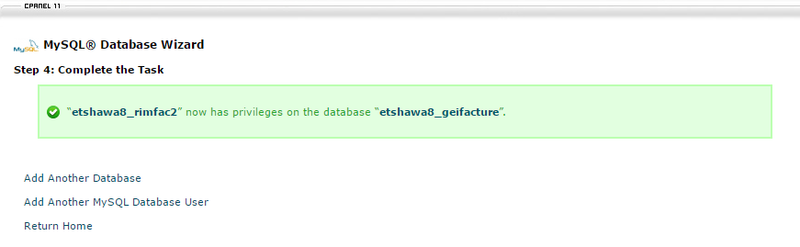
STEP 5
DONE

Slide 16
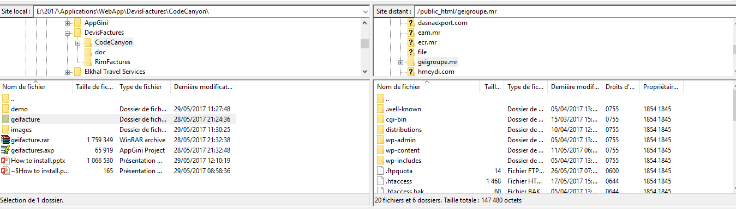
STEP 6
Upload ‘geifacture’ folder to your live server

Slide 17
STEP 7
Open your browser and type ‘YourURL/geifacture/’ and press ‘ENTER’
http://geigroupe.mr/geifacture/
If you want to run directly from your domain like this http://geigroupe.mr/. Place the content of geifacture folder directly on the root of your domain. Usually in public/html/
Click on ‘CONTINUE …’

Slide 18
STEP 8
Click on ‘THE GREEN BUTTON …’

Slide 19
STEP 9
Fill on ‘INFORMATIONS…’
database_name
database_username
database_password
user_name
email address to recover your password if lost
user_password
user_password
When done, click on ‘SUBMIT’

Slide 20
STEP 10
You are now ready to use the application.
You can click here to start using the application
Or you can click here to manage the application

Slide 21
THANK YOU

