Slide 1

GEIFACTURE
Quotes, Invoices
Single or Multi-users
Unlimited clients
Unlimited field
Unlimited Invoices
Unlimited Quotes
Detailed documentation is included
Multiple language support
Responsive layout
View record per Members
Import CSV data

Slide 2
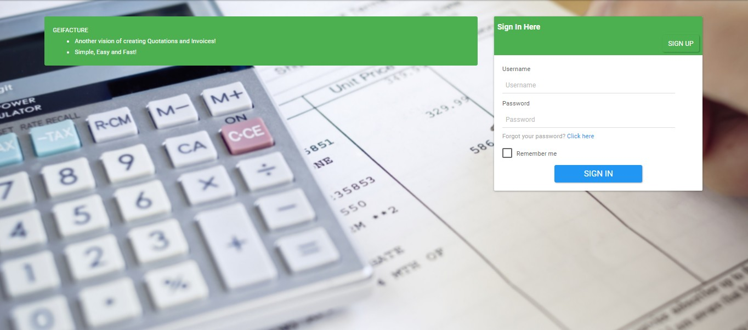
Login and registration

Slide 3
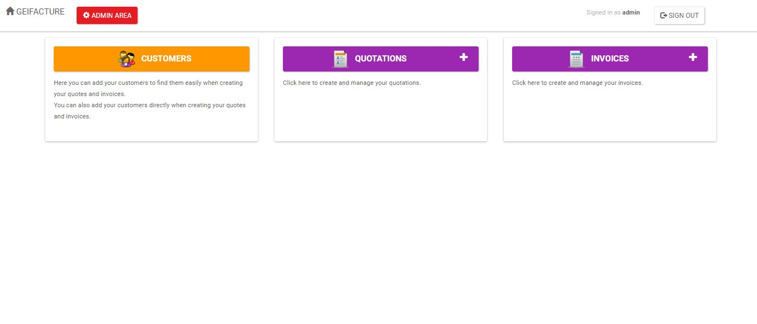
User interface

Slide 4
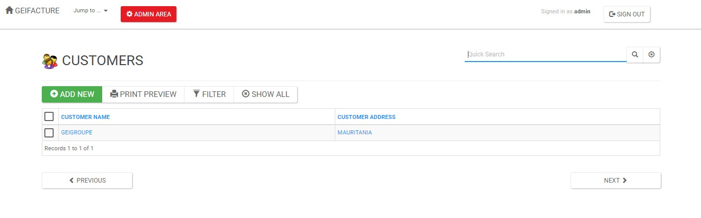
Create and manage clients

Slide 5
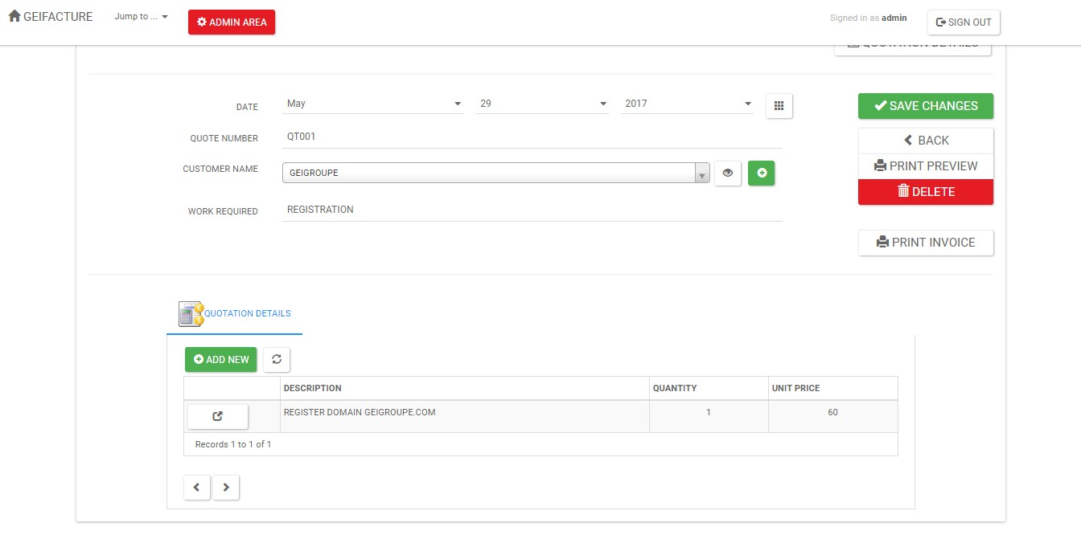
Create and manage Invoices

Slide 6
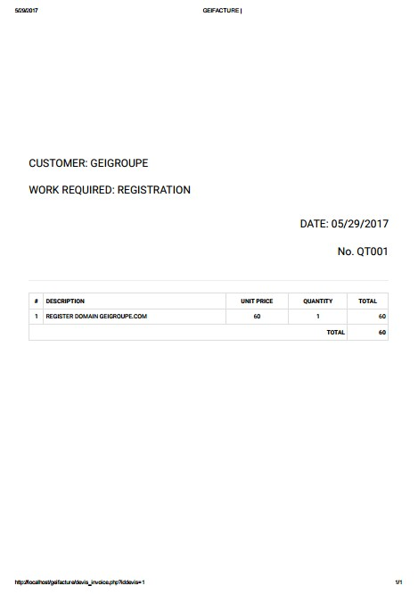
Print

Slide 7
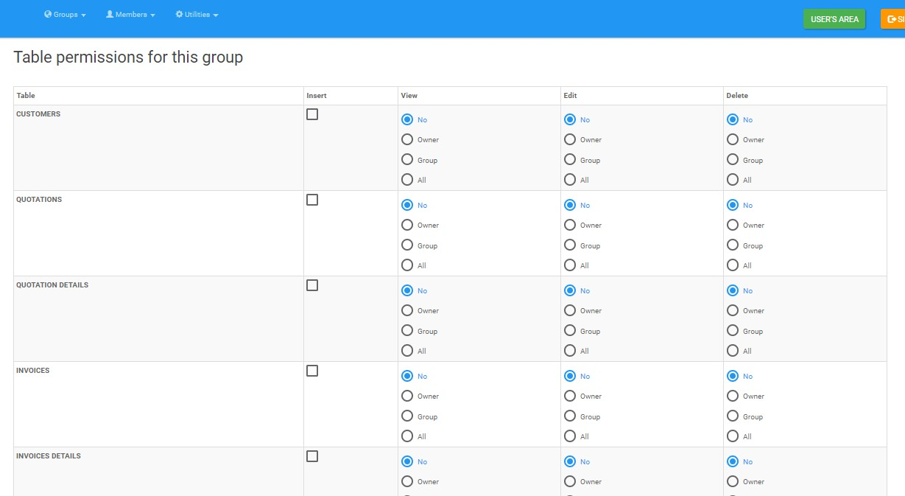
Permission

Slide 8
Permission

